Slide 1
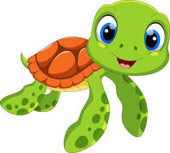
Turtles Group Phonics Phase 4
Monday April 20, 2020
Day 1

Slide 2
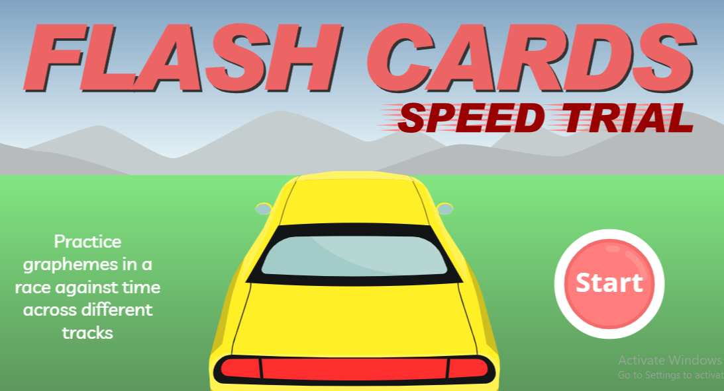
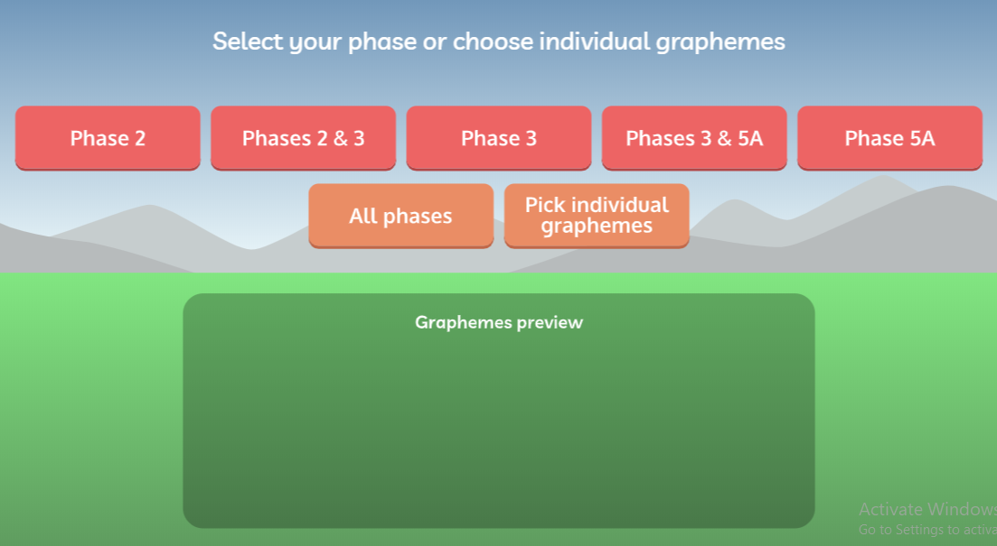
Play Phase 2 & 3 Phonics Flashcards Speed Trials
Instructions: Hover the mouse over the blue writing below, hold CTRL on keyboard and click the link. Or, copy and paste into your internet browser. If you need to login, use these details:
Username: march20 Password: home
https://new.phonicsplay.co.uk/resources/phase/4/flashcards-speed-trials

Slide 3
Join in with this Phase 3 Tricky Word song on YouTube:
https://www.youtube.com/watch?v=R087lYrRpgY

Slide 4
Can you read these tricky words?
were little there one

Slide 5
These words have adjacent consonants. That means two consonant letters that are next to each other. Can you read these words?
went best fond

Slide 6
These words have adjacent consonants. That means two consonant letters that are next to each other.
Ask an adult or older sibling to read the words to you. Can you spell them without looking?
tilt gust hand

Slide 7
Well done Turtles!
You completed Day 1!
☺

Slide 8
Turtles Group Phonics Phase 4
Tuesday April 21, 2020
Day 2

Slide 9
Play Phase 2 & 3 Phonics Flashcards Speed Trials
Instructions: Hover the mouse over the blue writing below, hold CTRL on keyboard and click the link. Or, copy and paste into your internet browser. If you need to login, use these details:
Username: march20 Password: home
https://new.phonicsplay.co.uk/resources/phase/4/flashcards-speed-trials

Slide 10
Join in with this Phase 3 Tricky Word song on YouTube:
https://www.youtube.com/watch?v=R087lYrRpgY

Slide 11
Can you read these tricky words?
they all are

Slide 12
Can you sound out and blend this sentence?
The clown did tricks with a chimpanzee.

Slide 13
Can you sound out and blend this sentence?
The frog jumps in the pond and swims off.

Slide 14
Well done Turtles!
You completed Day 2!
☺

Slide 15
Turtles Group Phonics Phase 4
Wednesday April 22, 2020
Day 3

Slide 16
Play Phase 2 & 3 Phonics Flashcards Speed Trials
Instructions: Hover the mouse over the blue writing below, hold CTRL on keyboard and click the link. Or, copy and paste into your internet browser. If you need to login, use these details:
Username: march20 Password: home
https://new.phonicsplay.co.uk/resources/phase/4/flashcards-speed-trials

Slide 17
Join in with this Phase 3 Tricky Word song on YouTube:
https://www.youtube.com/watch?v=R087lYrRpgY

Slide 18
Can you read these tricky words?
were little there one

Slide 19
Can you sound out and blend this sentence?
I must not tramp on the flowers.

Slide 20
Can you sound out and blend this sentence?
A crab crept into a crack in the rock.

Slide 21
Well done Turtles!
You completed Day 3!
☺

Slide 22
Turtles Group Phonics Phase 4
Thursday April 24, 2020
Day 4

Slide 23
Play Phase 2 & 3 Phonics Flashcards Speed Trials
Instructions: Hover the mouse over the blue writing below, hold CTRL on keyboard and click the link. Or, copy and paste into your internet browser. If you need to login, use these details:
Username: march20 Password: home
https://new.phonicsplay.co.uk/resources/phase/4/flashcards-speed-trials

Slide 24
Join in with this Phase 3 Tricky Word song on YouTube:
https://www.youtube.com/watch?v=R087lYrRpgY

Slide 25
Can you read these tricky words?
they all are

Slide 26
Can you sound out and blend this sentence?
A drip from the tap drops in the sink.

Slide 27
Can you sound out and blend this sentence?
I can hear twigs snapping in the wind.

Slide 28
Well done Turtles!
You completed Day 4!
That’s it for this week ☺

