Slide 1
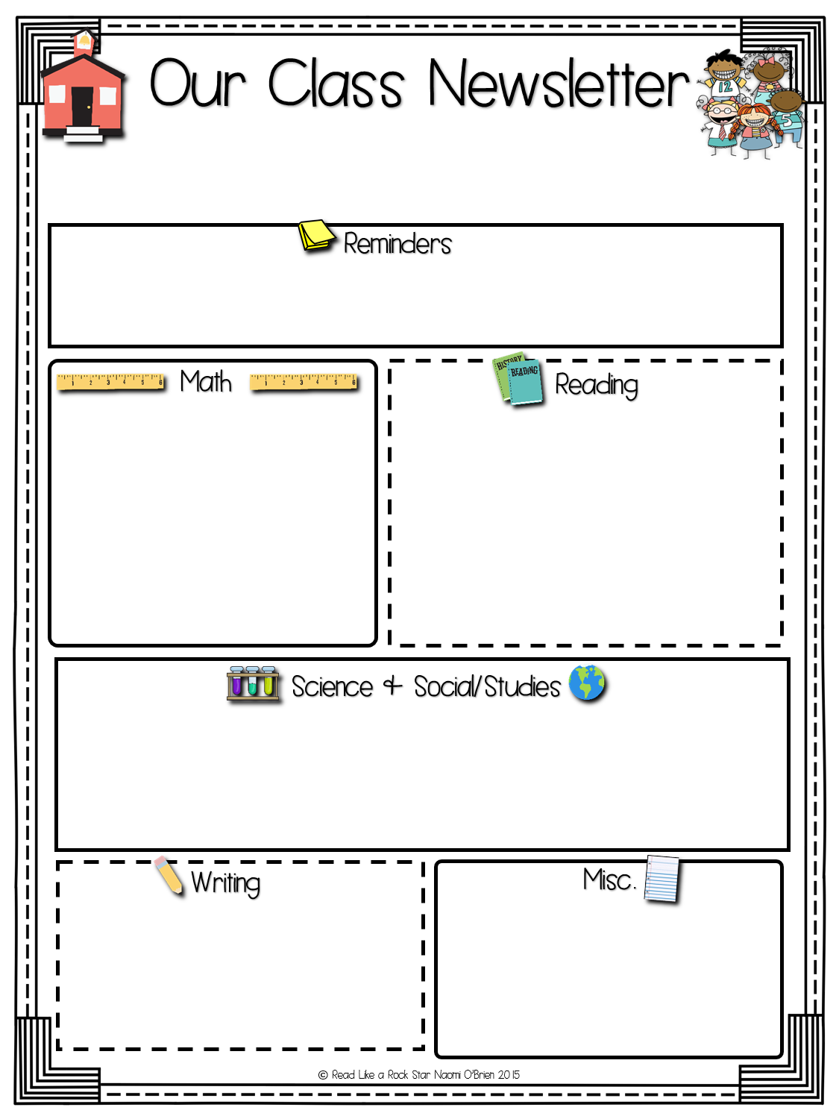
Grade 3
Week of: Sept. 9-13, 2019
Sept. 27- Charleston Wrap deadline and half day school due to PD(professional development day)
Students learnt how to read, write and identify place and value of each digit in a 4, 5 and 6 digit whole number. Students used MATH rotations to develop skills via hands on games, technology, independent practice and one and one with the teacher. Homework was given base on the specific needs of the student.
Students learnt how to identify, fix and write complete sentences. Students were also able to practice their comprehension skills, by listening to the teacher reading aloud and answering questions. Students are working on enhancing their oral communication skills by giving an oral book report on their weekly library books. Everyday the students are required to read at least 15 minutes outside of school.
In Science the students learnt about the parts of an ecosystem, types of ecosystems and plants and animals specific to aquatic and land ecosystems. A letter with a login to a Science website for this topic will be sent home on Monday 16 Sept, 2019. Please help your child interact with the material. Only view slides 1 to 11 for now.
In Social Students the students have been learning about basic need and natural disasters. A letter with information concerning the students first Social Studies project would be sent home on Monday 16th, Sept. 2019.
Grade 3 is currently working on developing their first expository piece.
Spelling words would be sent home on Monday 16th Sept, 2019.

